Slide 1
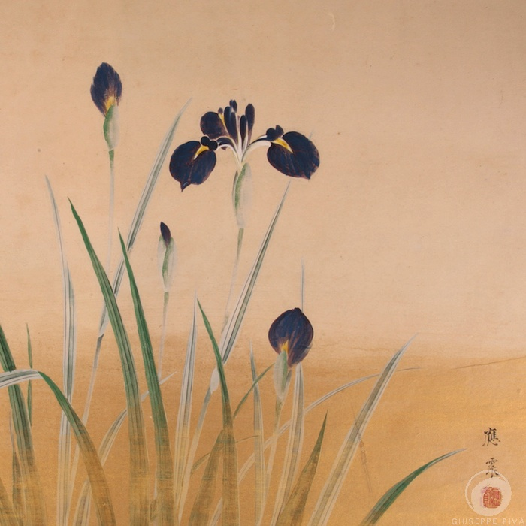
Sustainable Business Strategy Emersion Program in Japan
April 22-27, 2012
Learning the Art of Building Businesses to Last from the Masters of the 100 Year Strategy in Japan

Slide 2
A 5-Day Emersion Program Focused on Sustainable Business Strategies
Meet with top executives of Toray Industries, an $20 billion multi-national corporation
Tour the Toyota Factory in Nagoya and meet with top management
Travel to Kyoto to learn the art of making tea with Dr Genshitsu Sen, the 15th grand tea master
Spend a night in Houshi Ryokan, the world’s oldest continuously operating business, and learn about the 46th generation family run business and environmental sustainability used in managing the properties natural hot springs
Study simplicity at the UNESCO World Heritage site Ryoanji Zen Temple
Learn the key elements of sustainability in strategic planning as embraced by Japanese companies through faculty led discussions

Slide 3
BUSINESS PROCESS
STRATEGIC VISION
SUSTAINABLE OUTCOMES
Notes:
3

Slide 4
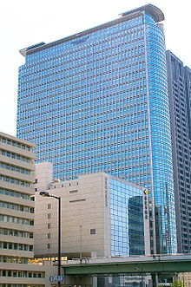
Toray Industries
Nagoya
$20 Billion in Revenue
World's largest carbon fiber manufacturer
Clients include aircraft, automobile, and wind power industry

Slide 5
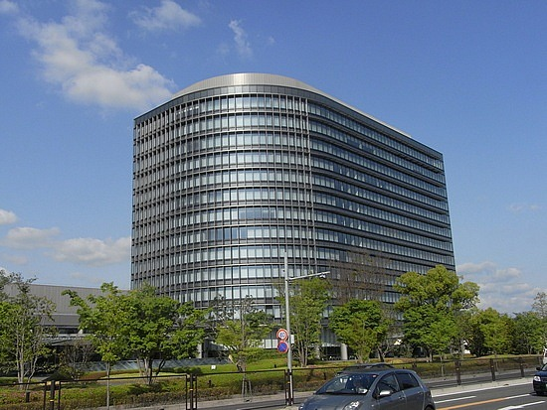
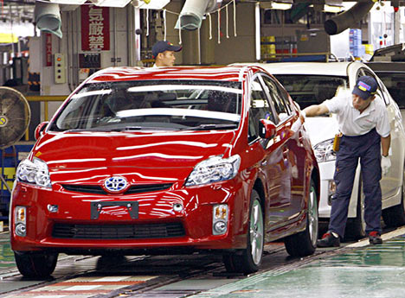
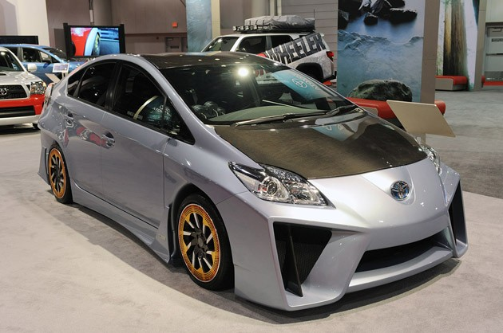

Toyota Motors
Nagoya

Slide 6
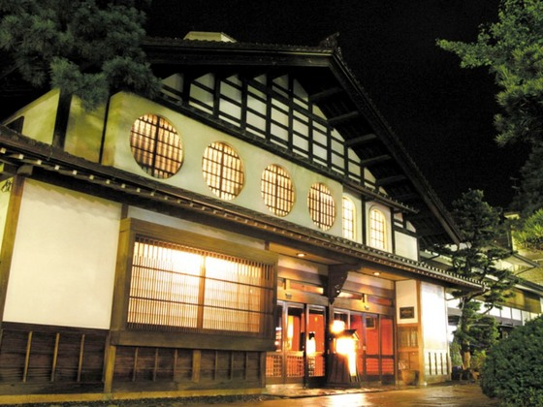
Visit Houshi Ryokan
Awazu, Ishikawa
World’s Oldest Continuously Operating Company
1300 years, 46 Generations

Slide 7
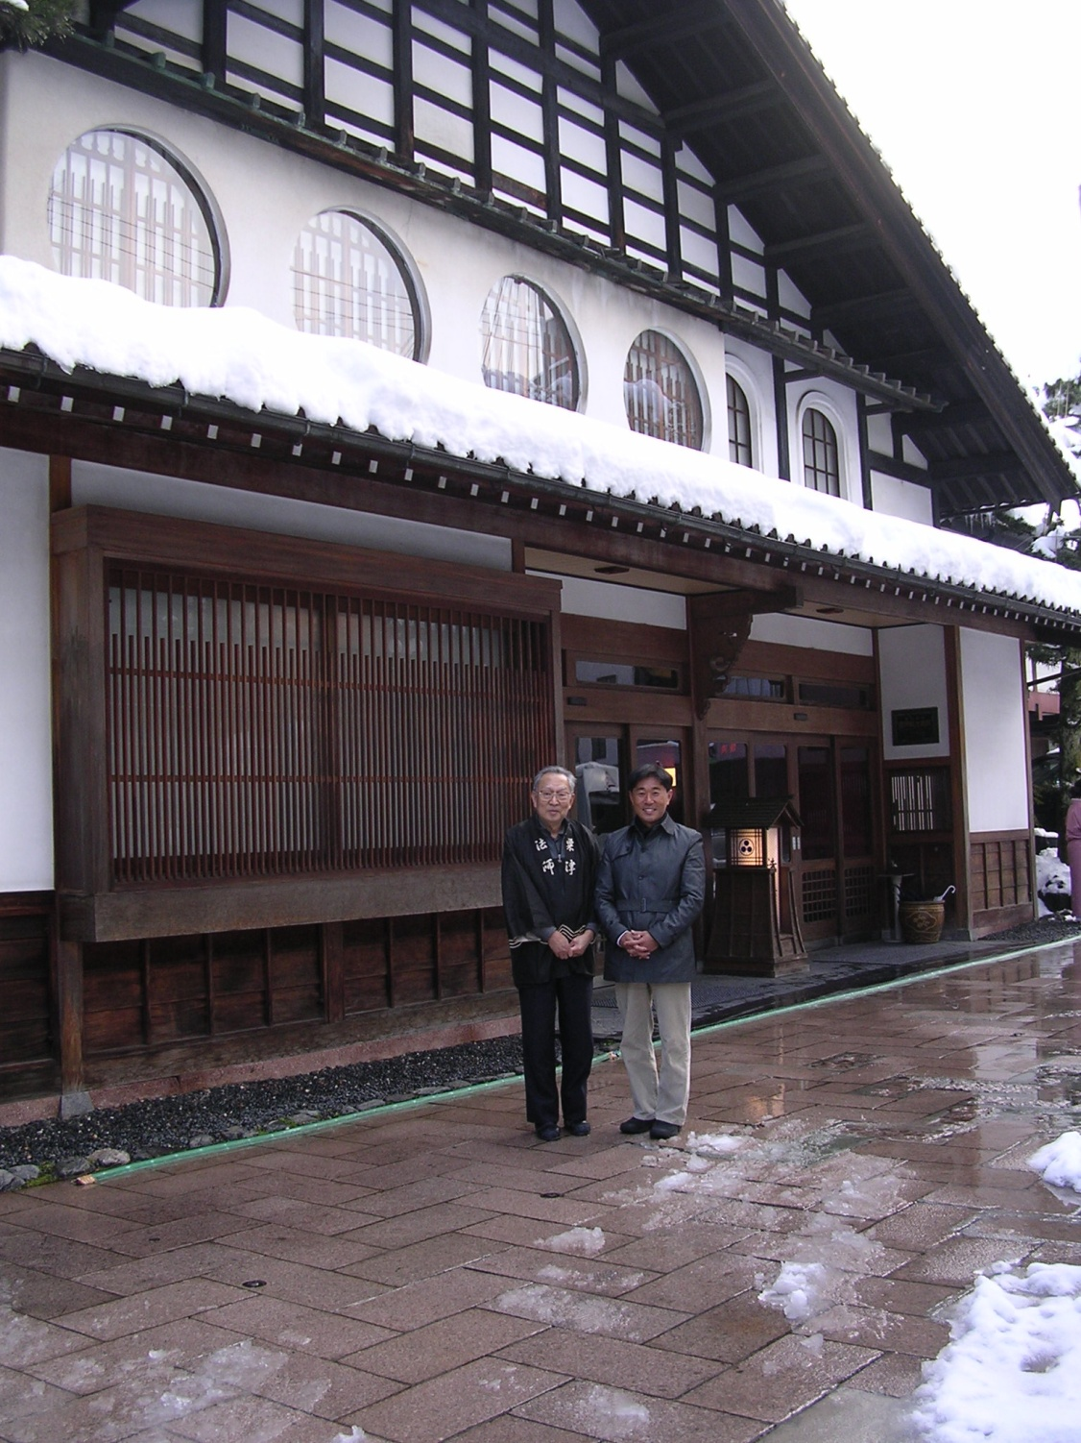
46th Hoshi Zengoro

Slide 8
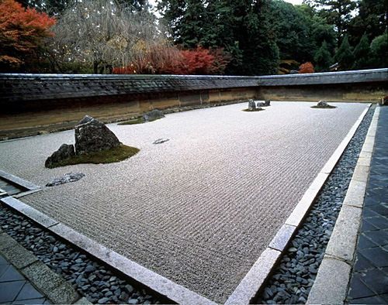
Ryoanji Zen Temple, Kyoto
UNESCO World Heritage

Slide 9
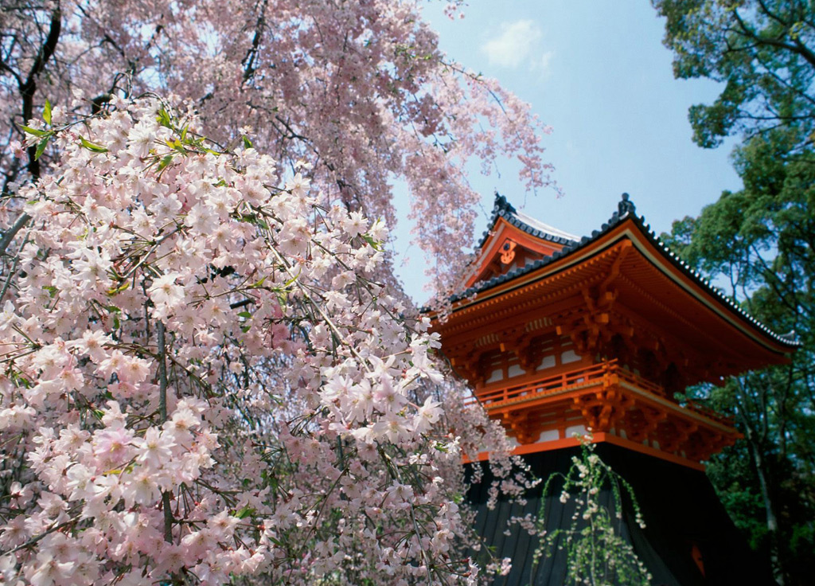
Ninna-ji Temple, Kyoto

Slide 10
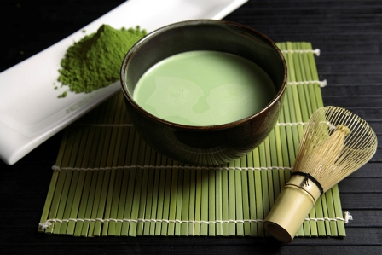
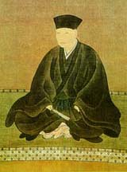
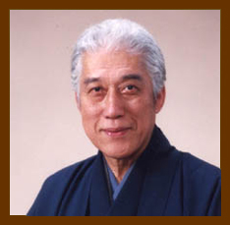
Meet the Grand Tea Master Learn the are of making tea
Kyoto
Sen Rikyu Sen Soshitsu XV
1522 - 1591 1923 -

Slide 11
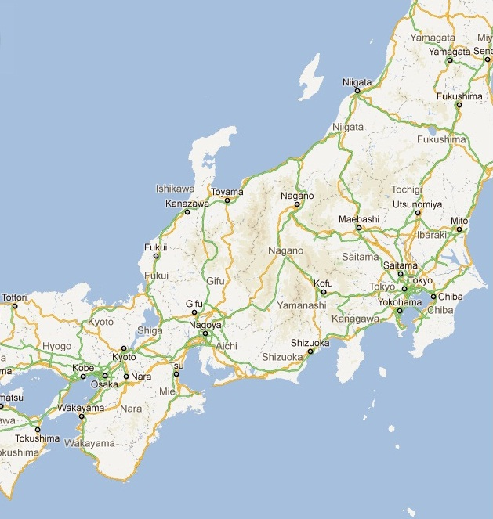
Travel from Nagoya to Awazu to Kyoto over the 5-day program in Sustainable Business Strategies
*Awazu
*Kyoto
*Nagoya

